Slide 1
2024-2025 Middle Schools Budget Presentation
March 25, 2024

Slide 2
Middle School Goals 2024-2025
Strategic Plan Priority Areas #1 and #3: Academic Excellence for All and Opportunity for Success
Increased focus on interventions for the whole child
MTSS whole child study teams - Branching Minds
School level meeting
Grade/course level meeting
Individual student meeting
On-going “Data Digs” to inform and drive instruction
Continued review of instructional materials including online platform for students and teachers
Ensuring resources align to NYS Next Gen Standards
Strategic Plan Priority Area #2: Social, Emotional, Mental Health Wellness for Students and Staff
Provide resources for staff to inform, maintain, and address mental wellness
Review the current data to assess the individual needs of our students (SECA Data)
Assess programs and additional resources that support the developmental characteristics of the middle level child
Recognize students who demonstrate positive character
Continued implementation of Harmony lessons through all content areas

Slide 3
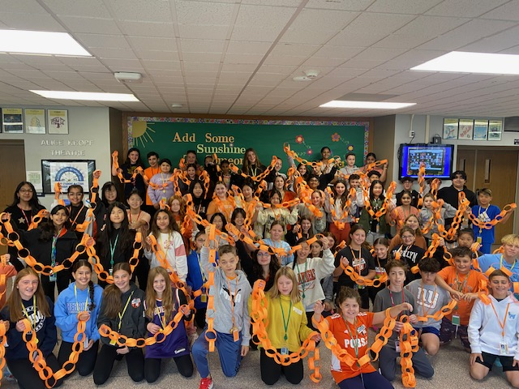
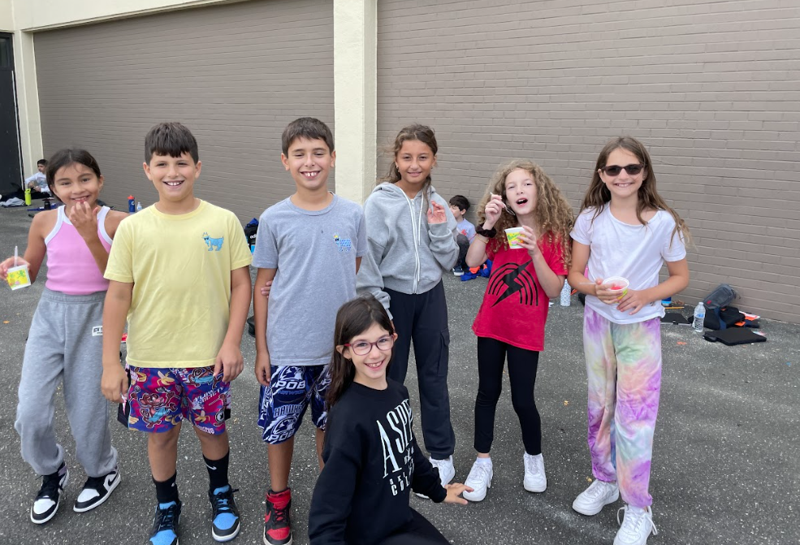
Points of Pride 2023-2024
Schoolwide Programs/Supports
Implementation of POB MTSS Plan
Implementation of Parent Square Communication Tool
Continuation of Fifth Grade Academy
Addressing executive functioning skills
Literacy Week
Continued Harmony lessons grades 5-8
Collaboration with PTA to engage our students in Cultural Arts programs
Developmental Guidance program
Peer Mentoring program for 8th graders in collaboration with HS students
HS 101
Career Café for 8th grade
Opportunities for student participation in clubs
Math Olympiad/AMC Math Participation

Slide 4
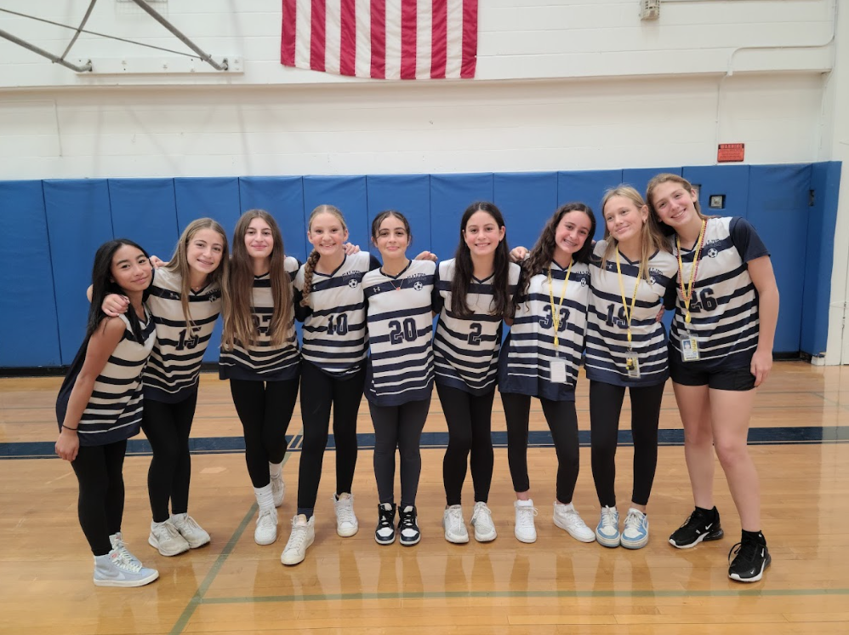
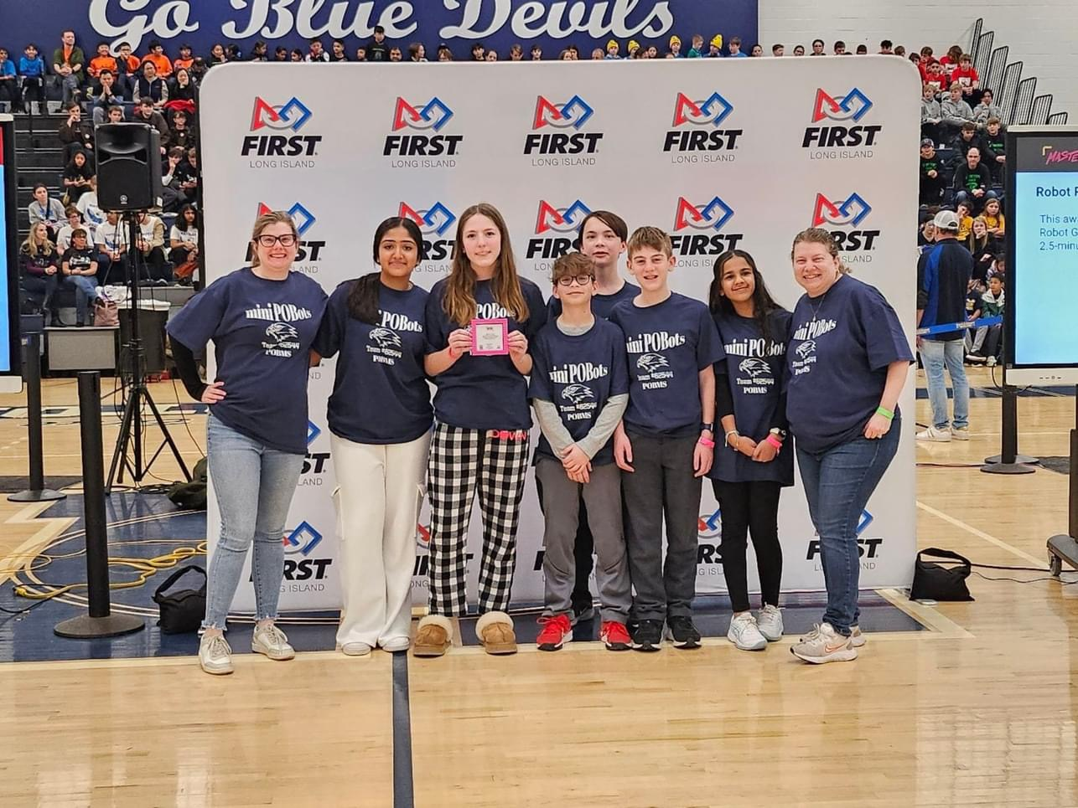
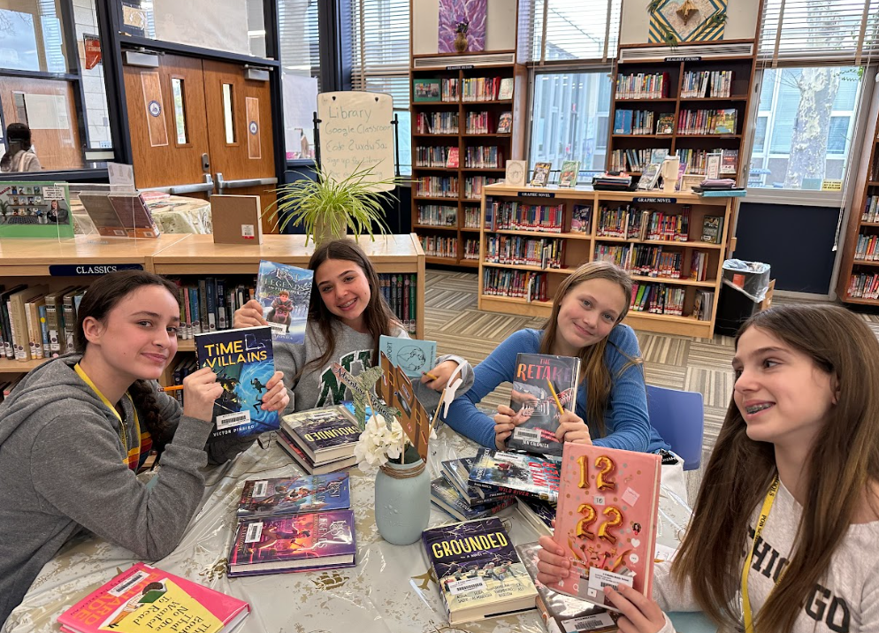
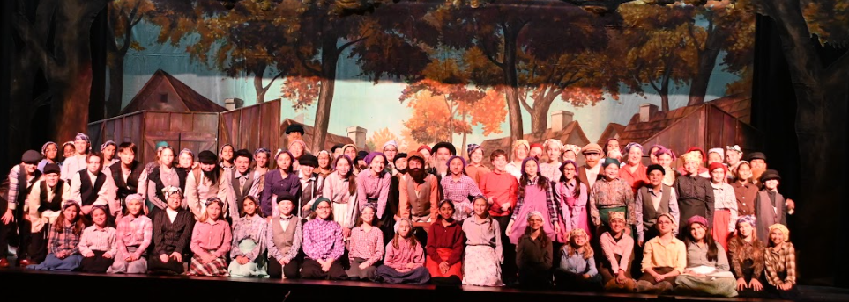
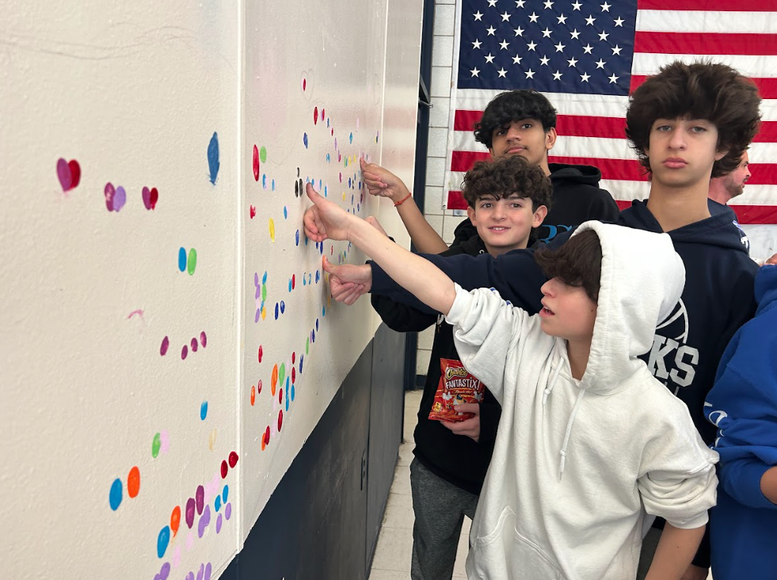
Points of Pride 2023-2024

Slide 5
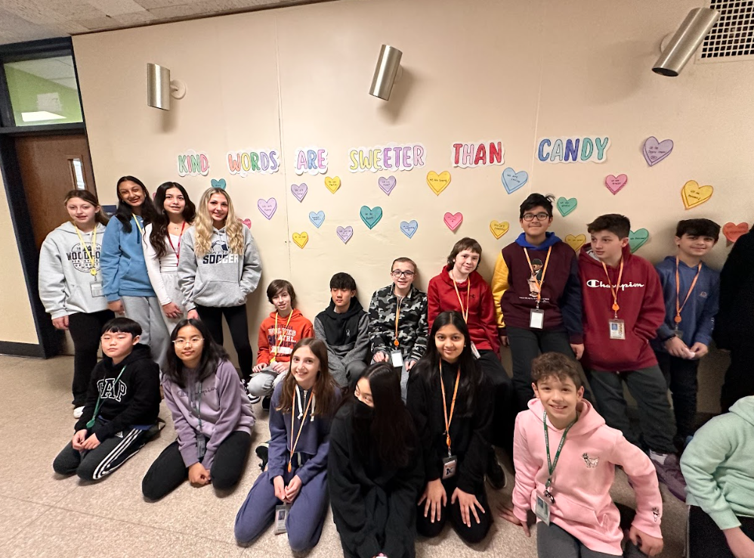
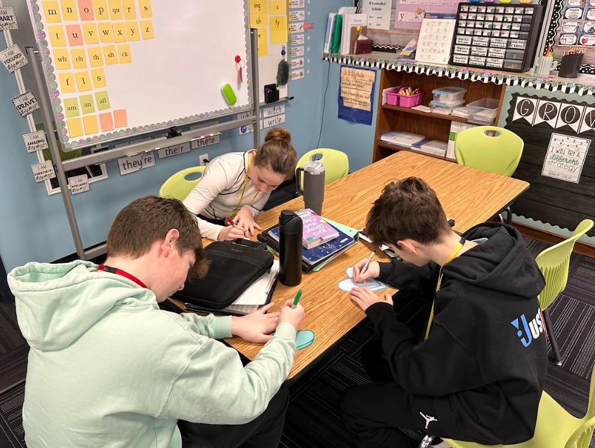
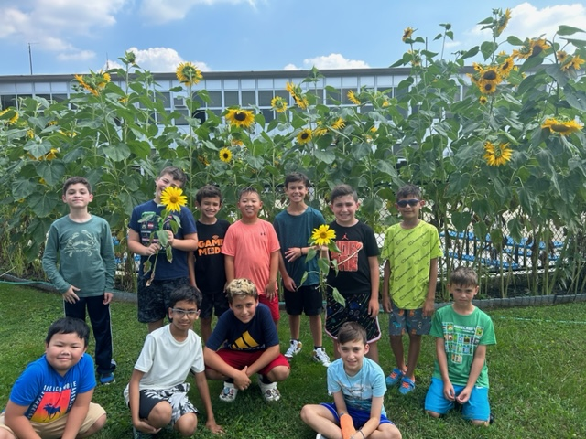
Planned Initiatives 2024-2025
Improved Instructional Spaces/Expanded Learning Experiences:
Expand on adaptable/flexible seating in all learning spaces
Courtyard beautification
Library Media Center renovation at POBMS
Continued implementation of K-12 technology initiatives to support learning

Slide 6
Budget Drivers 2024-2025
Budget Code | Description | 2023-2024 Budget | 2024- 2025 Proposed Budget | Dollar Difference | % Difference
A-2110-520-32-00-00 | MMS Supplies Instruction | $59,445 | $78,790 | $19,345 | 32.54%
A-2110-590-32-00-00 | MMS Equip. under $2,500 | $18,467 | $41,333 | $22,866 | 123.82%
A-2110-481-32-00-04 | Science Textbooks | $6,120 | $6,910 | $790 | 12.91%
A-2110-520-36-00-00 | POB Supplies Instruction | $77,185 | $75,030 | -$2,155 | -2.79%
A-2110-481-36-00-05 | ELA K-6 Textbooks | $18,275 | $13,969 | -$4,306 | -23.56%
A-2110-590-36-00-00 | POB Equip. under $2,500 | $13,340 | $42,550 | $29,210 | 218.97%
Mattlin Middle School
POB Middle School

Slide 7
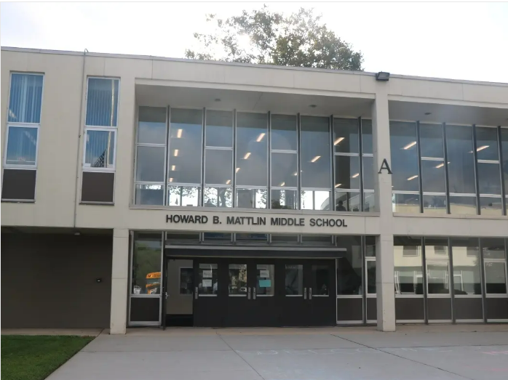
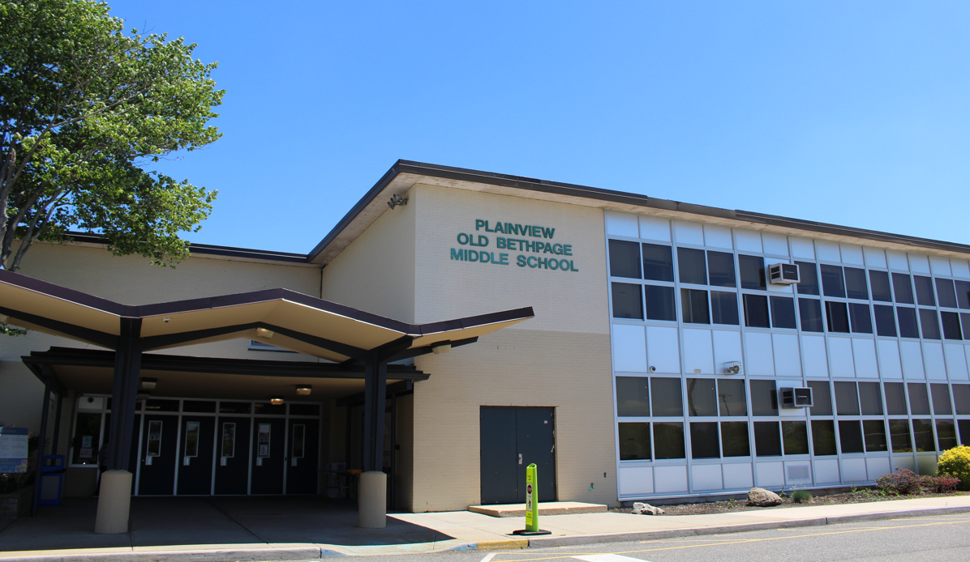
Middle School
Historical Perspective 2024-2025
Mattlin Middle School
2023-2024: $239,587
2024-2025: $239,220
Year-to-Year Change: -$367 or –0.15%
POB Middle School
2023-2024: $329,692
2024-2025: $278,451
Year-to-Year Change: -$51,241 or –15.54%

Slide 8
Vote!
When and Where?
Tuesday, May 21, 2024
6am-9pm
Jamaica Avenue School
Mattlin Middle School-Administration Offices
www.pobschools.org for more information

Slide 9
A Smart Investment
Thank You!

